Slide 1
Too many events happening around your city
Information overload and choice paradox
Lack of personalization and interest
Generic recommendations and disorganized information
Budget and time constraints
Additional planning and scheduling needed within a budget
EVENTOPIA

Slide 2
A smart event-planning app that personalizes event recommendations, optimizes itineraries based on budget and time, and leverages user preferences (including optional browsing history analysis) to ensure a seamless and enjoyable experience.
EVENTOPIA

Slide 3
EVENTOPIA
Your personalized solution for discovering and planning events.

Slide 4
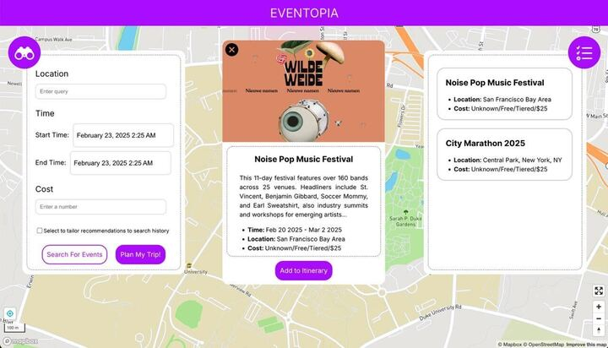
Event Discovery
01
We curate and recommend events based on user interests and geolocation, eliminating the need for manual searching.
EVENTOPIA

Slide 5
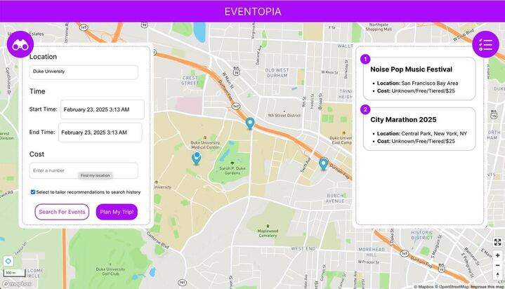
Itinerary Planning
02
We design an efficient schedule by grouping nearby events within a user’s available time window and budget, ensuring they maximize their experience.
EVENTOPIA

Slide 6







Tech Stack
Front End
React, Typescript, HTML, CSS
Back End
Flask, Python, SearchAPI
Gen AI Integration
Gemini 2.0 flash (Multimodal)
EVENTOPIA

Slide 7
Understanding the market
Hyperlocal Services Market CAGR: 15.6%
Events Industry CAGR: 9.7%
Target Audience:
[Primary] Young professionals, students, and families (ages 18-40) with diverse interests, living in urban areas, who want to optimize their leisure time.
[Secondary] Event organizers and local venues seeking to attract more attendees through personalized event promotion.
Global Hyperlocal Event Discovery Market
USD 34 Billion
SAM Estimate
USD 4 Billion
Revenue Model:
Freemium model, Partnerships and Advertising
Unique Selling Proposition (USP):
Leveraging digital technologies and mobile apps to connect users with nearby events.
Emphasizing personalized experiences and supporting local businesses and communities.
Integrating with other hyperlocal services to provide a comprehensive local experience.
US PA Market
USD 67 Million
Competitor Analysis:
[Direct Competitors] Eventbrite, Meetup, Facebook Events
[Indirect Competitors] Google Calendar, Yelp, TripAdvisor
EVENTOPIA

Slide 8
What’s upcoming?
Real time integration across groups and calendars to coordinate schedules
Post event feedback and recommendations
Real time updates and notifications
Robust user history from social media platforms
EVENTOPIA

Slide 9




Thank you!
Questions?
Adil Gazder
(adil.gazder@duke.edu)
Neha Senthil
(neha.senthil@duke.edu)
Selina Zhan
(Selina.zhan@duke.edu)
Mobasserul Haque (mohammedmobasserul.haque@duke.edu)
EVENTOPIA

